Slide 1
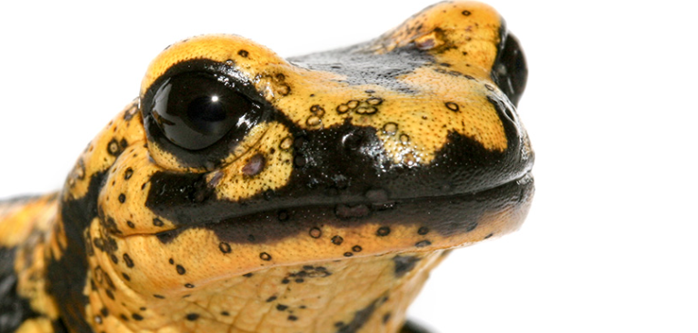
Duplex qPCR for Rapid Simultaneous Detection of B. dendrobatidis and B. salamandrivorans in Amphibian Samples
(Blooi, Mark, et al. 2013)
[Halley Deme, Sydney Purcell, Molly Regan]
Environmental Genomics
April 24th, 2025

Slide 2
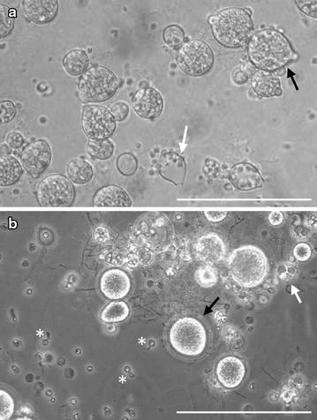
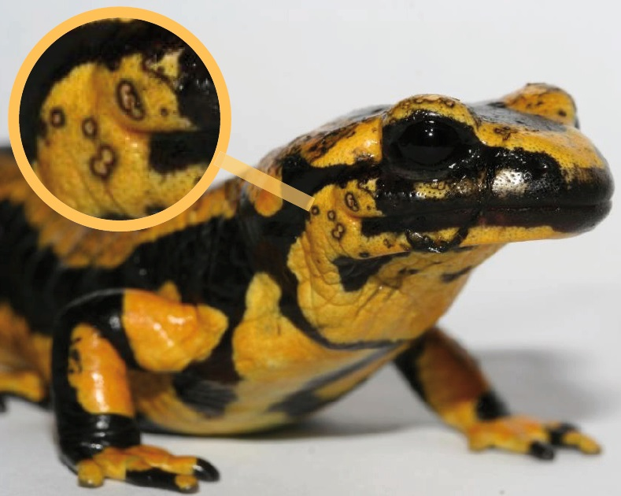
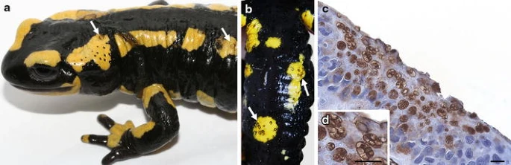
Purpose
Figure 1. Morphology of Batrachochytrium species in culture.
Insights into the prevalence of fungal pathogens
Batrachochytrium dendrobatidis (Bd)
Batrachochytrium salamandrivorans (Bsal)
How it affects salamander populations?
Study the impact of these pathogens in both adult and juvenile members of the population.
Understand how their health influences ecological balance.
Figure 3. Fire salamander with circular skin lesions surrounded by black border © A. Martel & F. Pasmans (Ghent University)
Figure 2. Clinical signs and pathology associated with infection due to Batrachochytrium salamandrivorans.
Notes:
The purpose of our project was to study the prevalence of the fungal pathogens Bd and Bsal and their presence in salamander
populations. It’s important to know which populations are infected to understand the spread and how it affects the populations.
Figure 1 shows a culture of Bd with the black arrow pointing to zoospores and Bsal with zoospore cysts. Figure 2 and 3 show how
the fungus looks on the salamanders once they are infected creating skin lesions.
Figure 2: Morphology of Batrachochytrium species in culture. a Culture of B. dendrobatidis on tryptone/gelatin-hydrolysate/lactose (TGhL)-broth, showing abundant mature zoosporangia (black arrow) containing zoospores and empty, discharged sporangia (white arrow); b In culture (TGhL-broth) B. salamandrivorans is characterized by predominant monocentric thalli (black arrow), few colonial thalli (white arrow) and zoospore cysts with germ tubes (asterisk); scale bars 100 µm
Figure 5: Clinical signs and pathology associated with infection due to Batrachochytrium salamandrivorans. a a naturally infected fire salamander (Salamandra salamandra) found during a B. salamandrivorans-outbreak (Robertville, Belgium) showing several ulcers (white arrows) and excessive skin shedding; b extensive ulceration (white arrows) at the ventral side of an infected fire salamander; c skin section through an ulcer evidences abundant intracellular colonial thalli in all epidermal skin layers; immunohistochemical stain with polyclonal antibodies to B. dendrobatidis; scale bar 10 µm; d magnification of the intracellular colonial thalli from micrograph c; immunohistochemical stain; scale bar 10 µm

Slide 3
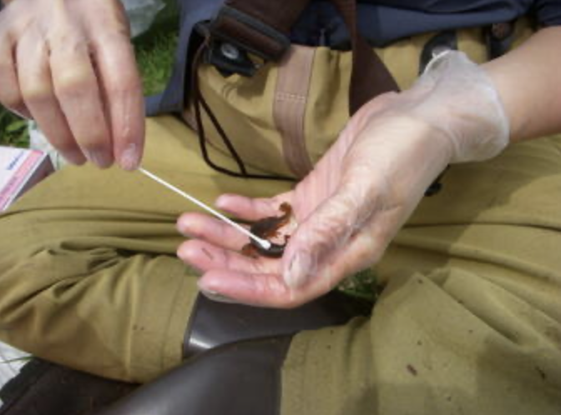
Hypothesis
We expect to see higher Bd infection load scores in adults compared to juveniles.
Sexually mature salamanders get infected during fights with rivals and when mating.
Also, we expect to see more Bd amplification compared to Bsal.
The National Wildlife Health Center (NWHC) and the United States Geological Survey (USGS) Amphibian Research Monitoring Initiative (ARMI) are surveilling and mitigating potential spread of Bsal.
Figure 4. “USGS scientist swabbing a Central Newt in Wisconsin to look for an invasive fungus, Batrachochytrium salamandrivorans (Bsal)”
Notes:
We hypothesized that we would see more Bd present in the adult samples because they have more contact with other
adult salamanders during fights with rivals and during mating compared to juveniles. Based on current surveying results
we hypothesized that our we would see more Bd than Bsal in our amplification results.

Slide 4
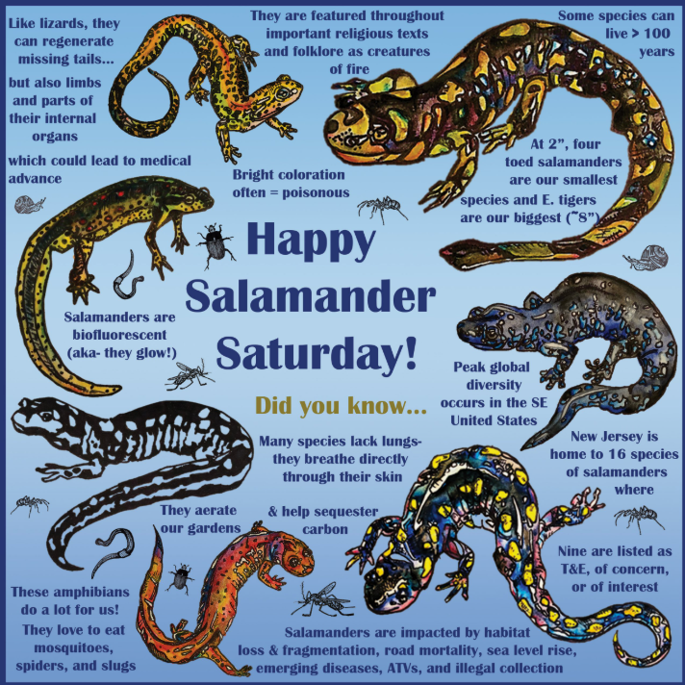
Broader Impacts
Salamanders play a pivotal role in their ecosystems.
They are both predator and prey
Bioindicators of environmental health
Their declining health due to disease poses a threat to biodiversity and ecological stability.
Also, they have the ability to regenerate limbs and repair tissue which scientists are interested in.
Figure 5. Infographic created for CWF’s Salamander Saturday Celebration.
Notes:
Salamanders act as both predator and prey in an ecosystem by consuming mosquitoes, spiders and slugs and are food some
mammals like river otters. They are a great indicator of the environmental health of a region and their limb regeneration could help
scientists make medical advances.

Slide 5
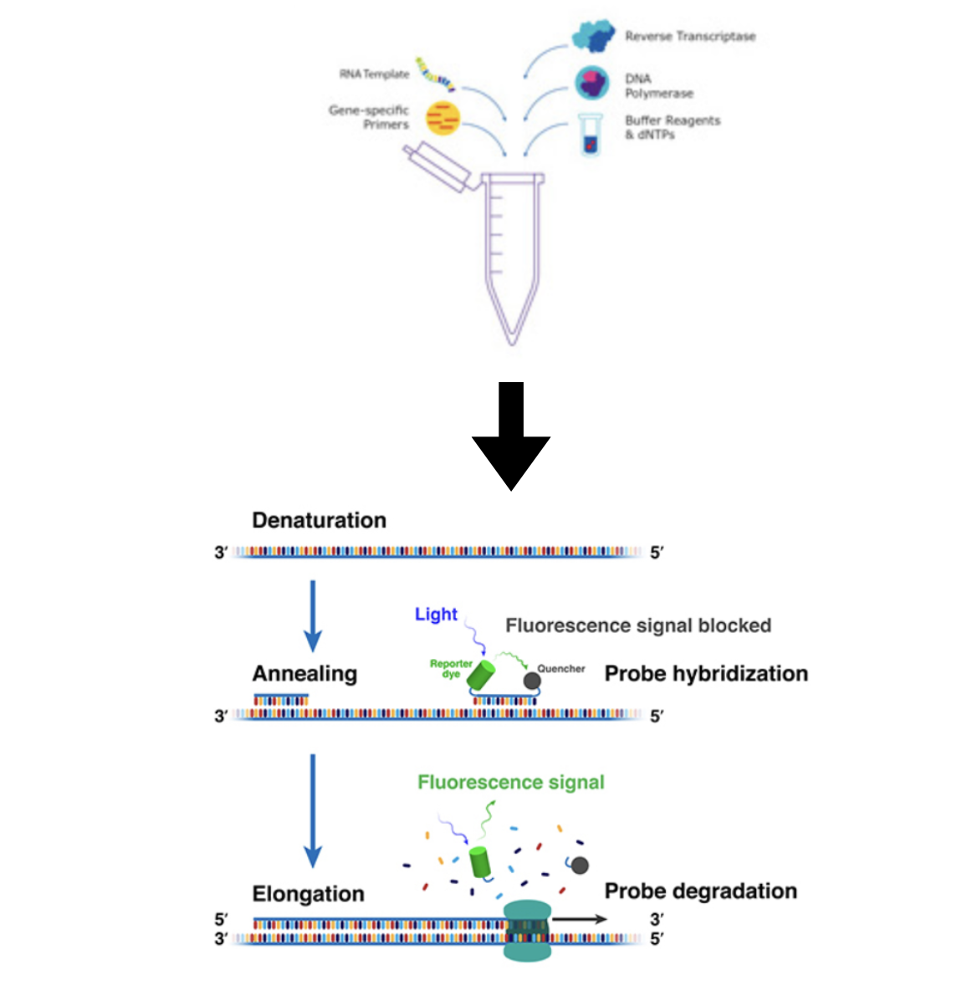
Methods
DNA was extracted from existing salamander samples from Rochester, NY.
29 Samples tested for B. dendrobatidis and B. salamandrivorans using qPCR.
(Blooi et al. 2013)
Duplex TaqMan assay (triplicate) primers and probes specific to the strains based on their Internal Transcribed Spacer (ITS) region.
Used the Thermo Fisher Scientific's QuantStudio software to run qPCR and compile data.
Used Excel/ Google Sheets to formulated figures and carry out statistical analysis.
Figure 6. Schematic of DNA extraction and qPCR workflow used for the detection of Bd and Bsal in salamander samples.
Notes:
standard curve generated from known BD standards (10-1-10-5 ), with the unknown samples plotted on the line of best fit.

Slide 6
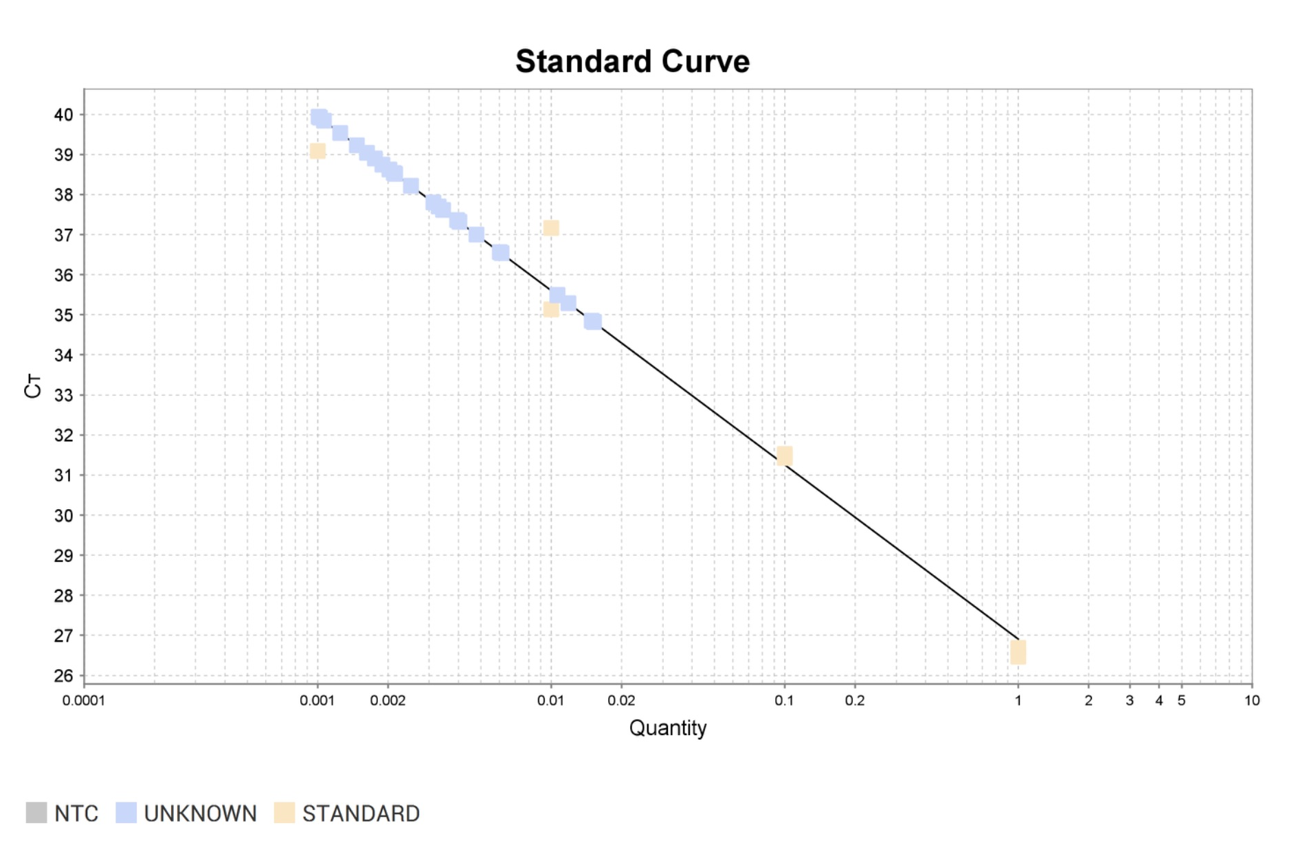
Results
Figure 7. Standard curve generated from known BD standards
(10⁻¹ - 10 ⁻⁵ ), with the unknown samples plotted on the line of best fit.
Notes:
Figure 7 shows the standard curve generated from a 10-fold dilution serin Bd DNA concentrations, ranging from 10−1 to 10−5.
es of knowThe standard curve validates the assay’s ability to accurately detect and quantify Bd/Bsal by relating Ct values of known concentrations of target DNA.
The resulting Ct values demonstrated strong linear correlation, which indicates high assay reliability.

Slide 7
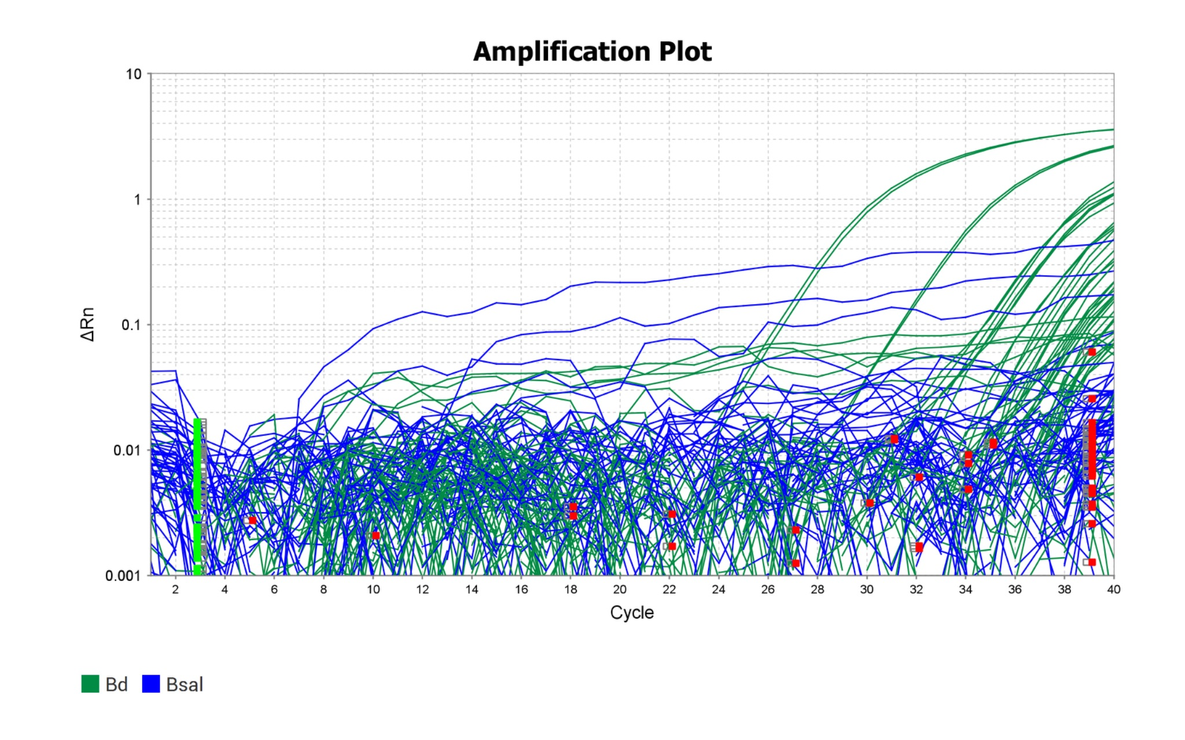
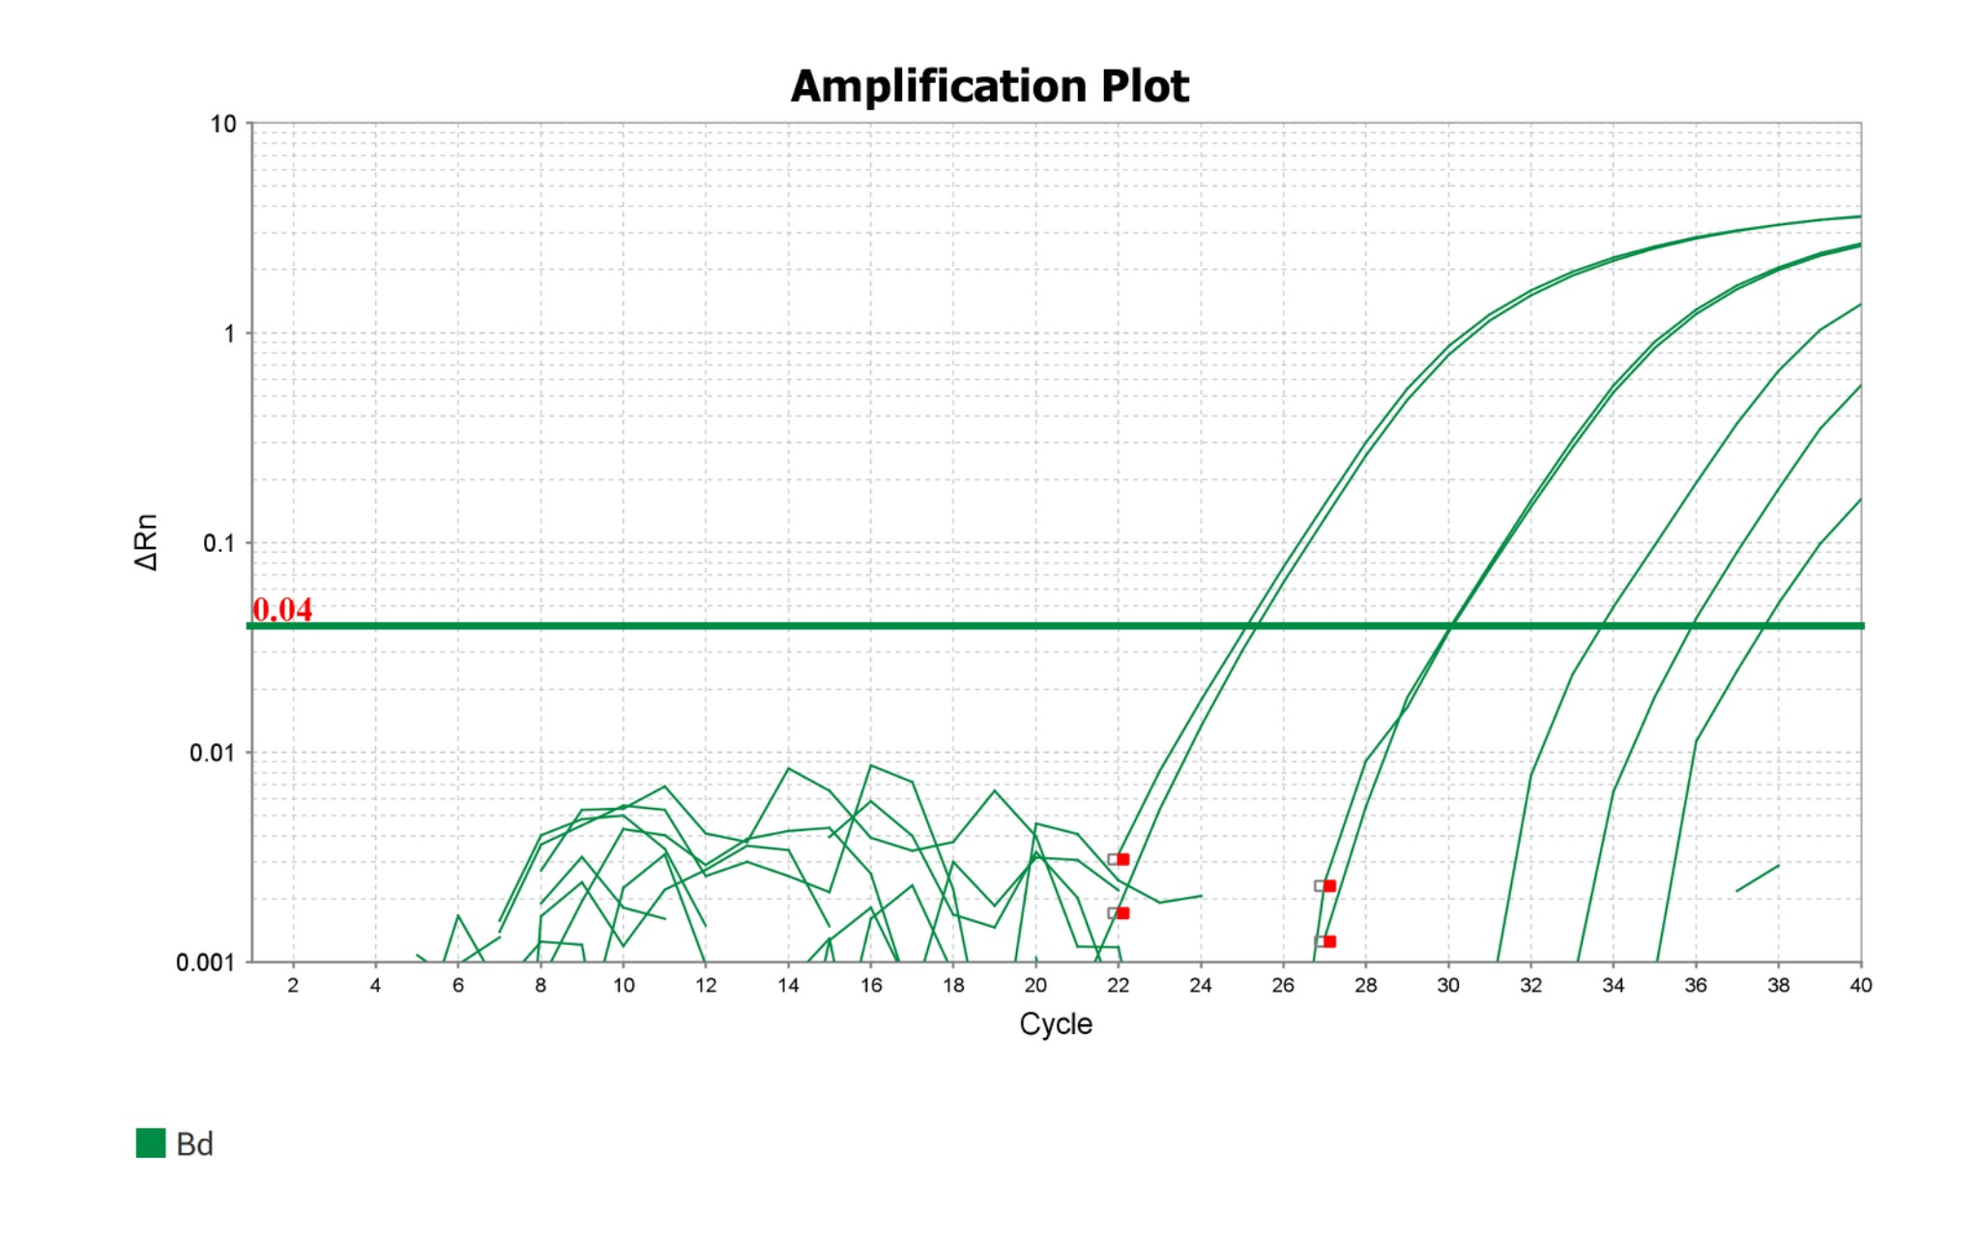
Results
Figure 8. Amplification plot of Bd and Bsal
Figure 9. Amplification plot of only Bd
Notes:
Figure 8 and Figure 9 show two separate amplification plots:
8 showing both Bd and Bsal amplification curves and 9 showing only Bd. The combined plot was initially used to assess co-infection and amplification behavior of both pathogens.
However, the Bsal curves showed significant background noise and irregular amplification patterns. Which we figured may happen due to the fact that bsal is not actually present and we had some trouble setting the PCR system to the exact fluorophore, so there is going to be a lot of background noise.
That’s why we have a separate amplification plot focusing exclusively on Bd which we know is actually present. There is a little bit of background noise but we moved the threshold to avoid it and be in the middle of these peaks showing actual amplification of BD.

Slide 8
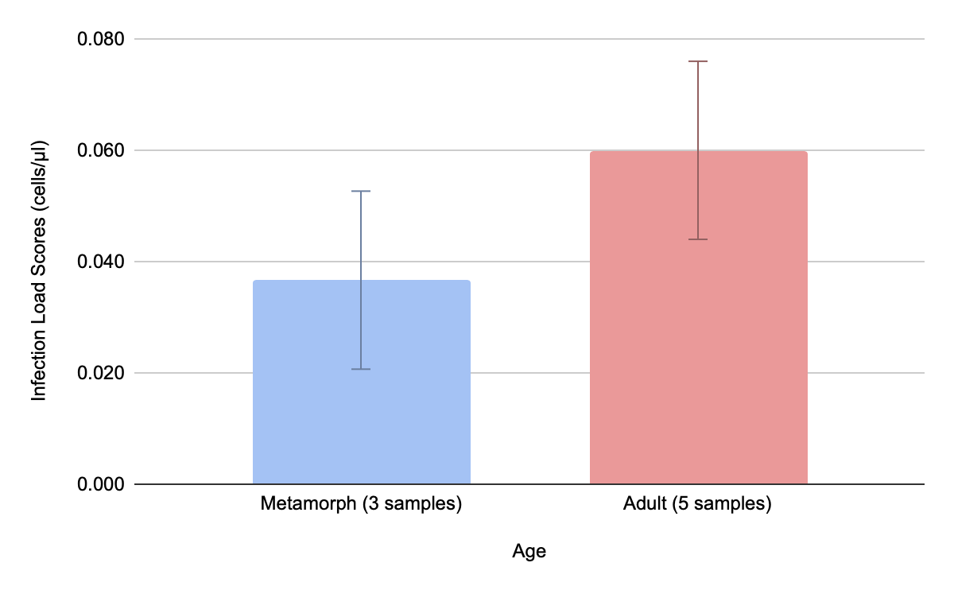
Results
Metamorph (3 samples)
Quantity Mean: 0.037
Adult (5 samples) Quantity Mean: 0.06
Standard Deviation: 0.0165
Figure 10. Comparison of average adult vs. metamorph positive infection load scores
Notes:
Figure 10 compares average infection load scores between metamorph and adult salamanders with positive Bd detections.
Just for clarification, a metamorph is an amphibian that has just recently undergone metamorphosis, so transitioned from the larval/aquatic stage to terrestrial/juvenile stage. May have lost its gills, very small, may have lungs now, starting to live on land.
There we 5 samples for adults and 3 samples for metamorph salamanders that had positive bd detection. No juveniles had positive detecitons.
Adults exhibited a higher mean infection load (0.06 cells/μL) than metamorphs (0.037 cells/μL).
Standard deviation across all positive samples was 0.0165, suggesting moderate variability. These results may indicate that adult individuals, are more likely to carry higher pathogen loads compared to recently metamorphosed individuals.

Slide 9
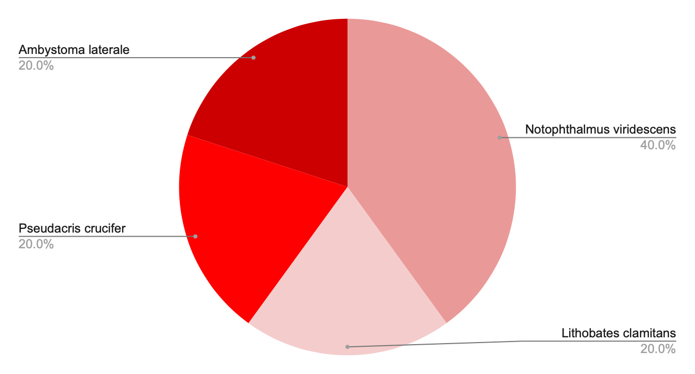
Results
*Metamorph samples only had 1 species with positive infection load scores.
Figure 11. Percentages of host species of adults with positive infection load scores
Notes:
Figure 11 illustrates the distribution of adult host species that tested positive for Bd infection. So this is based of the 5 samples. Notophthalmus viridescens (NO TOE FTHAL MUS - VER UH DES INTS) represented the largest proportion of infected adult hosts at 40%, followed by Ambystoma laterale (AMBUH STOMA LAT ER UL), Pseudacris crucifer (SUE DACK REES CRU CI FER) , and Lithobates clamitans (LITHO BATES CLAM UH TINS) (each at 20%).
Among the metamorph samples, only one species, Ambystoma laterale, showed a positive infection load. So all three of the samples were Ambystoma laterale. This limited diversity in positive detections could reflect species-specific susceptibility, sample size limitations, or environmental exposure differences during the metamorphic stage.

Slide 10
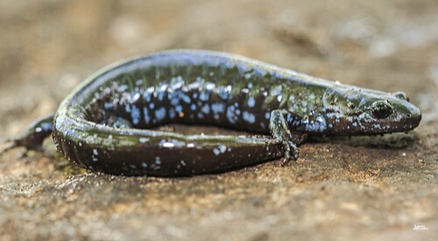
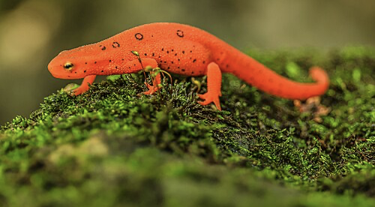
Extra
Figure 12. Blue-spotted salamander (Ambystoma laterale)
Figure 13. Eastern newt (Notophthalmus viridescens)
Notes:
Figure 12. Shows the blue-spotted salamander or Ambystoma laterale, Figure 13. Shows the eastern newt or Notophthalmus viridescens.
This is slide us trying to figure out why these host species were the most prevalent of our samples.
The blue-spotted salamander is one of five species of New York salamanders indigenous to New York.
Also, Blue spotted salamanders, are not strong burrowers, and can be found close to or on the ground's surface. So they were probably easier to catch.
Why were all the metamorphs Ambystoma Laterale?
Maybe A. laterale metamorphosed during the sampling window, while other species didn't. It could be a seasonal issue.
The eastern newt adults are fully aquatic, making them more exposed to Bd/Bsal, which are waterborne. N. viridescens is well-documented as a highly susceptible species to Bd. Also eastern newts are one of the most common types of salamanders in New York. So they were probably going to pop up.

Slide 11
Sources
Blooi, Mark, et al. "Duplex real-time PCR for rapid simultaneous detection of Batrachochytrium dendrobatidis and Batrachochytrium salamandrivorans in amphibian samples." Journal of clinical microbiology 51.12 (2013): 4173-4177.
A. Martel, et al “ Recent introduction of a chytrid fungus endangers Western Palearctic salamanders.” Science 346:630–631 (2014)
Evan H. Campbell Grant, et al. 2015 “Salamander Chytrid Fungus (Batrachochytrium salamandrivorans) in the United States—Developing Research, Monitoring, and Management Strategies” USGS Open-File Report 2015–1233 (2015)
Van Rooij, P., Martel, A., Haesebrouck, F. et al. Amphibian chytridiomycosis: a review with focus on fungus-host interactions. Vet Res 46, 137 (2015)
Parrott, J.C., Shepack, A., Burkart, D. et al. Survey of Pathogenic Chytrid Fungi (Batrachochytrium dendrobatidis and B. salamandrivorans) in Salamanders from Three Mountain Ranges in Europe and the Americas. EcoHealth 14, 296–302 (2017).
Housekeeping rules: Why reference genes matter in jute plants. Research Outreach. (2023, November 8). https://researchoutreach.org/articles/housekeeping-rules-why-reference-genes-matter-jute-plants/
Methods Image: https://1.bp.blogspot.com/ and https://researchoutreach.org
Batrachochytrium salamandrivorans (Bsal). (2019, June 5). USGS. https://www.usgs.gov/centers/nwhc/science/batrachochytrium-salamandrivorans-bsal
Emmanuel, J. (2024, August 17). 15 types of salamanders in New York. Animal of Things. https://animalofthings.com/types-of-salamanders-in-new-york/
Barnhart. Batrachochytrium salamandrivorans ELICITS ACUTE STRESS RESPONSE IN SPOTTED SALAMANDERS BUT NOT INFECTION OR MORTALITY. Anim Conserv. 2020 Oct;23(5):533-546.
https://conservewildlifenj.org/2024/05/16/raising-awareness-for-amphibians/

Slide 12
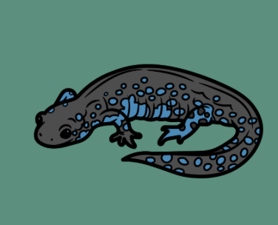
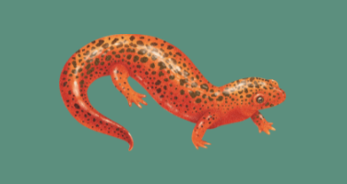
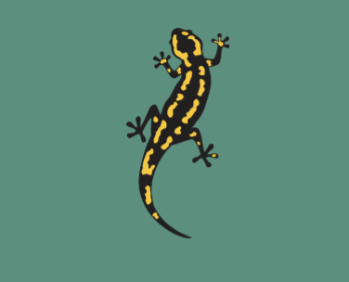
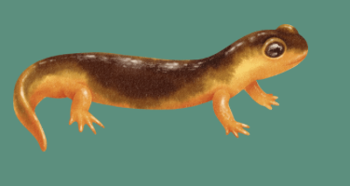
THANK YOU!

